Slide 1
Vikings
Adventures of the Northmen

Slide 2
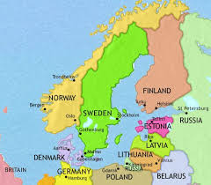
Where are the Viking from?
They sailed, traded, and raided across the Northern and central Europe during the 8th century to the late 11th century
Scandinavia
The Vikings came from Norway, Sweden, and Denmark. This area is known as Scandinavia!

Slide 3
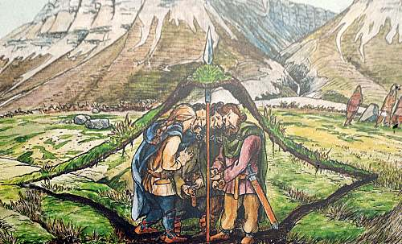
What kind of a people were the Vikings?
Farmers
Traders
Adventurers
Pirates?
Notes:
The Vikings were the people who lived from the 8th century to the 11th century in Scandinavia. They sailed around most of Europe, raiding, trading, and spreading their influence. Their main goal was to search for new and fertile land to settle on, in order to accomplish this their love for sailing granted them the ability to travel to far off lands and eventually discover countries such as Iceland, Greenland, Canada(known as Newfoundland at the time) and eventually the Mediterranean Sea.
If the Viking people were not sailing around and searching for new and fertile land, they were generally trading or selling their goods throughout markets. They flourished the lands with goods such as jewelry, tools, fur, and slaves.
A typical Viking was much more than just someone who went on raids for riches, fame, and women. There was, of course, some Vikings who did nothing else than to fight and serve their Jail or King, but that was more the exception then it was the norm.
Most of the Vikings were actually just ordinary people whom indeed their own business and spend their days by taking care of their farm and family.
“Viking actually means piracy or a pirate raid”(Heath and McBride 1985:4)

Slide 4
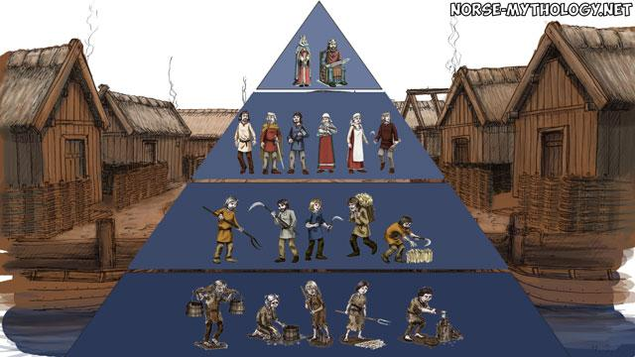
Social class structure
King/Queen/Earl
Jarls
Karls
Slaves
Notes:
The viking society was divided into a hierarchy of four social classes. At the bottom were the slaves, above the slaves were the Karls, in the middle were the Jarls, and at the otp were the royals, such as the Kings and Queen.
You were not stuck your whole life if you were born into one of these social classes. It was possible to move up and down the latter, depending on your luck and your choices in life(Destiny).
Being a slave in the Viking age, was as your can imagine not a very good life. You were at the mercy of your owners, and they could do pretty much anything to you that they wanted. This meant no personal freedom.

Slide 5
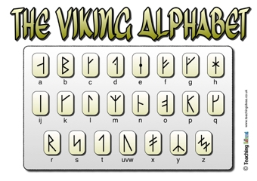
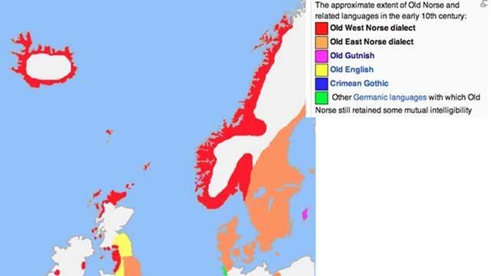
What language did they speak?
The Viking society created their own alphabet, outside of the traditional latin based letters, called younger futhark.
Spoke “Old Norse” which is difficult to translate but resembles the Swedish language
Runes
Sagas
Notes:
The Icelandic language is the closest of the Scandinavian languages to Old Norse, and that is probably because they have been isolated in the middle of the North Atlantic Ocean. 1

Slide 6
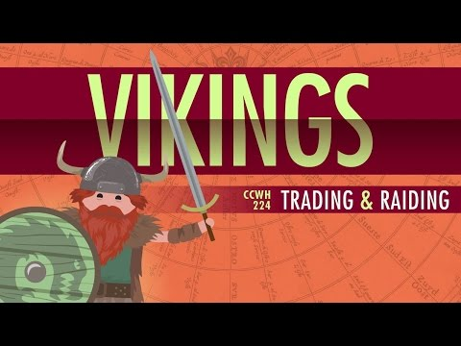
The Viking Expansion!
From AD 800 to 1200
Viking raids occurred all over Great Britain, France and even
Notes:
The subsequent Viking expansion was motivated by population pressure, economic growth, conflict within Norse society, and aggression toward those in other societies.1 The colonization and conquest of territory outside Scandinavia relieved pressures placed on the population caused by an imbalance between its size and the amount of resources available. The Viking Expansion was an adaptation that provided access to the additional resources needed to restore this imbalance and accommodate further growth.
How could a small and scattered people conquer so much territory? The Norwegian Vikings are characterized by their courageous, fatalistic outlook which made them naturally born risk takers. The raiding groups seem to have had a fantastic ability to shrug off losses, whether in land battles or in dangerous sea expeditions. The number of deaths caused by war was sometimes shockingly high in relation to the total Viking population, but it did not satisfy their hunger for conquest and exploration for around 250 years.

Slide 7
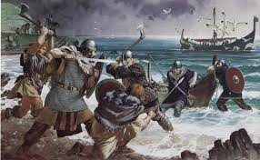
Why did they raid?
Hope for new land
Overpopulated homeland
Economic growth
Internal conflicts
External aggression

Slide 8
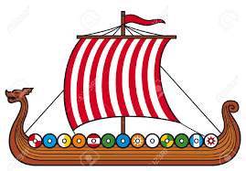
How did they raid?
Vikings were masters of the sea!
Longships powered by sails or oars
Generally traveled in large numbers
Sun based compass
Notes:
Many people have heard about these Viking raids before, but these raids in Scandinavia was not something new at this time in history, it had taken place for hundreds of years. However, it was the advancements in technology that lead to new opportunities, and there can be no doubt that it was the advancement in seafaring technology, that laid the foundation for what today is known as the Viking phenomenon.
It was the development of a new ship type, The Viking ship, that made it possible for the expansion of Scandinavian civilization into literally all directions. This new ship type made it possible to sail faster and further away from their homeland in a very short amount of time.(norse-mythology)

Slide 9
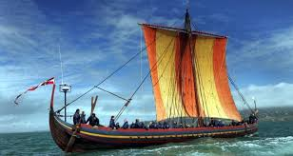
When did they raid?
Roughly 750 AD to 1200 AD
Initial voyage would be around breakup ( April/May)
Typically lasted 6-8 months but could last years!

Slide 10
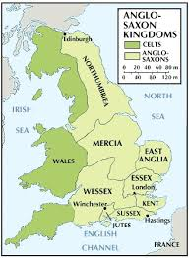
Who did they raid?
And what was going on there?
Great Britain was the main target for a long time.
Regions such as Wessex, Merica, North Umbria, and East Anglia.
Eventually making what is called “Danelaw” which turned roughly 2/3rds of Britain into a battlefield

Slide 11
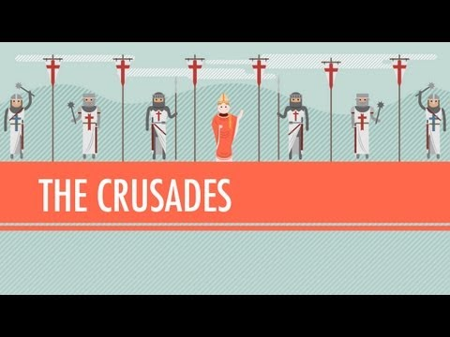
Who did they raid?
And what was going on there?
Great Britain was also fighting another set of wars at the time!
The Crusades!!!
In order to combat the Viking, the pope decided to offer the them wealth and glory for fighting alongside the Christians during the 1st and 2nd Crusades

Slide 12
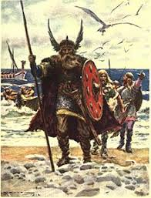
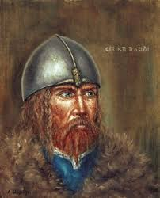
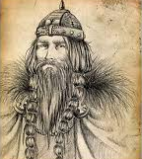
Major Players
Leif Erikson
Spread Christianity to Greenland
Son of Erik the Red
Rumored to have traveled to North America 4 centuries prior to Christopher Columbus
Erik the Red
Exiled from Norway for murder and settled Greenland
Made his fortune from the major resource in Greenland, lumber
Harald Bluetooth, yes that bluetooth
First King to rule all of Denmark
Introduced Christianity to Denmark
Bluetooth technology was named after him because the creators thought it would unite the world like Harald united Denmark
Notes:
Leif Erikson was a norse explorer from Iceland. HE was the first known European to have set foot on the continental North America, before Christopher Columbus. According to the Sagas of Icelanders, he established a norse settlement at Vinland, tentatively identified with the Norse l’Anse aux Meadows on the northern tip of Newfoundland in modern day Canada
Eric Thorvaldsson, AKA Erik the Red, was a norse explorer described in medieval and Icelandic saga sources as having founded the first settlement in Greenland. According to Icelandic sagas, he was born in the JAeren district of Rogaland, Norway, as the son of Thorvald Asvaldsson. He therefore also appears, patronymic ally as Thorvaldsson. The appellation “The Red” Mostly likely refers to the color of his beard.

Slide 13
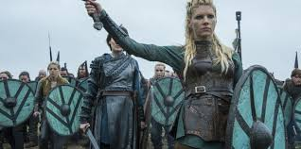
Viking Culture
Viking culture was highly based off of land ownership.
They believe their destiny was already planned out and live their lives accordingly.
Had immense family pride
Religion ran most of their lives
Notes:
The private ownership of land in the Viking Age was the basis of wealth, freedom, and influence in Scandinavian society. The selling, or losing through conflict, fo land was interpreted as a sign of extreme poverty.

Slide 14
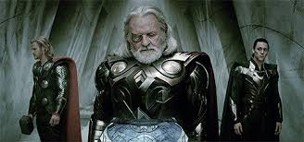
Viking Religion...before Christianity
Although technically we do not know the true name(we just refer to it as Old Norse) for the Viking religion and their belief system was complex we do understand the basics.
Polytheistic
Odin
Thor
Ragnarok

Slide 15
Why are the Vikings important?
The Viking peoples proved that traveling across large portions of land was possible.
They opened European eyes to the importance of land defenses against navy's.
Bolstered the Christian religion among European nations.
Created the first parliamentary government system

